Slide 1
Logistic Regression
Machine learning 102

Slide 2
Binary ClassificatioN
0
1

Slide 4
Data representation
Input Data (x)?
3D Matrix [4 x 4 x 3]
2D Matrix [4 x 12]
Greyscale [4 x 4]
Label (y)
1 - it’s a cat
0 - it’s not a cat

Slide 5
LINEAR Regression
Used weights (w) and bias (b) to predict an outcome (y’)
y’ = w^{T}x + b, where
y’ is a number, not a class

Slide 6
Logistic Regression
In binary classification we want a yes / no answer, so
y’ becomes the probability that it’s a yes
y’ is a value between 0 and 1 (e.g. 0.75 means the model is 75% certain it’s a cat)
So y’ = w^{T}x + b won’t work

Slide 7
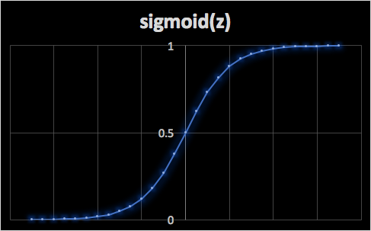
Logistic Regression - SIGMOID FUNCTION
In Logistic regression we want y’ to be between 0 and 1
y’ = 𝞼(w^{T}x + b)
𝞼(z) = 1 / (1 + e^{-z})
Intuition:
As z becomes large, e^{-z} tends to zero
𝞼(z) = 1 / (1 + small) ~= 1
As z becomes negative, e^{-z} tends to large
𝞼(z) = 1 / (1 + large) ~= 0

Slide 8
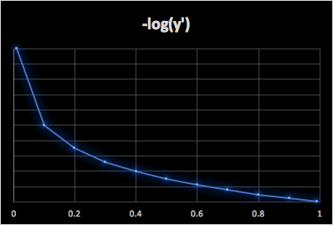
Logistic Regression - LOSS Function
l(y’, y) = 1/2 * (y’ - y)² but this function is not convex
So we use:
l(y’, y) = -(y * log(y’) + (1-y) * log(1-y’))
Intuition:
If y = 1, then l(y’, y) = -log(y’), so as y’ tends to 1, the loss is small
If y = 0, then l(y’, y) = -log(1-y’), so as y’ tends to 0, the loss is small

Slide 9
LOGISTIC REGRESSION - COST FUNCTION
Apply the loss function to each pair of labels:
J(w, b) = 1/m * sum of ( l(y’^{(i)}, y^{(i)}) )
or in full
J(w, b) = 1/m * sum of ( -(y^{(i)} * log(y’^{(i)}) + (1-y^{(i)}) * log (1- y’^{(i)}) )

Slide 10
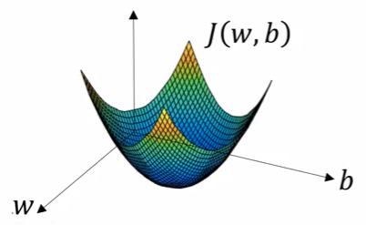
LOGISTIC REGRESSION - Gradient Descent
Want to find w, b that minimise J(w, b)
This is a convex function:
Repeat { w := w - alpha * dJ(w, b) / dw b := b - alpha * dJ(w, b) / db }
So take the partial derivative of each factor (the slope) multiplied by the learning rate αlpha

